Slide 1








Event Management System
RITIK JANARDHAN KOLI
Play Framework
Kafka
Akka
Scala

Slide 2
















PROBLEM STATEMENT
Team Coordination Challenges
Manual Timeline Issues
Event managers struggle to coordinate multiple service teams effectively, leading to inefficiencies.
Manual timelines cause delays and miscommunication between different event components.
Lack of Automated Tracking
No Real-time Notifications
No automated reminders or progress tracking systems result in missed deadlines and forgotten tasks.
absence of real-time notifications or alerting systems leads to delayed responses to critical events.
Event Management System
2/11

Slide 3















SOLUTION & APPROACH
Play Framework
Kafka
Akka
Monolithic backend
Message broker
Microservice
MySQL
Persistence
Play Framework
Kafka
Akka
• Events, Tasks, Issues, Teams management
• Producers for event notifications
• Consumer + Scheduler + Email service
• REST APIs for resource manipulation
• Event-driven, decoupled communication
• Classic Actors
• Scalable message queuing
• Akka Streams for Kafka consumption
Event Management System
3/11

Slide 4
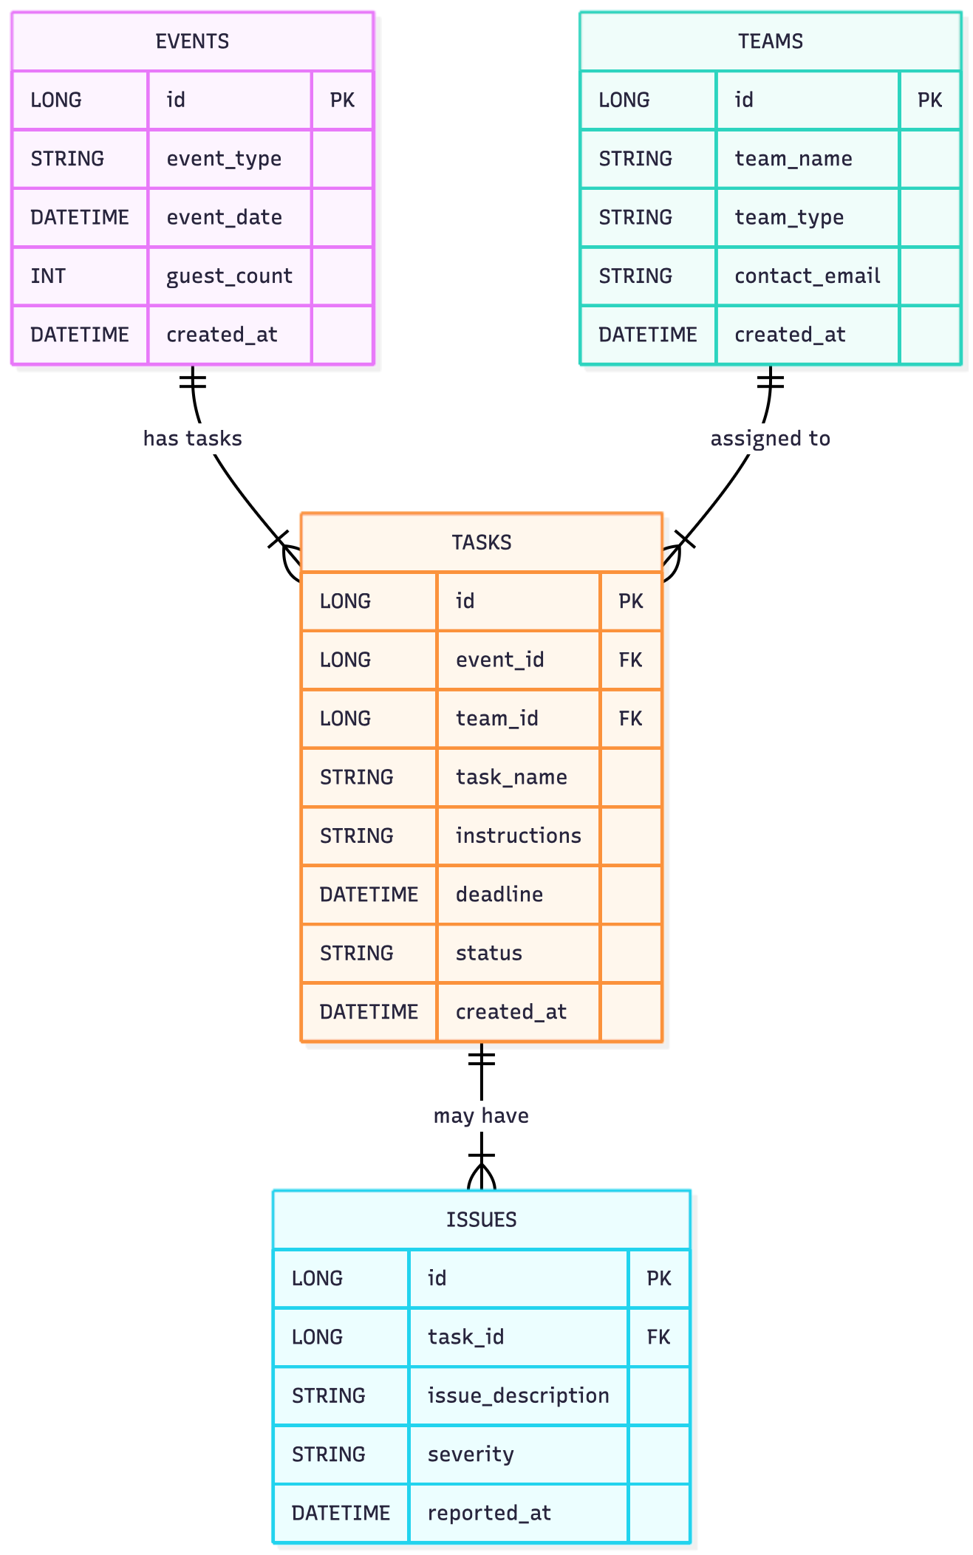
ER DIAGRAM
Event Management System
4/11

Slide 5
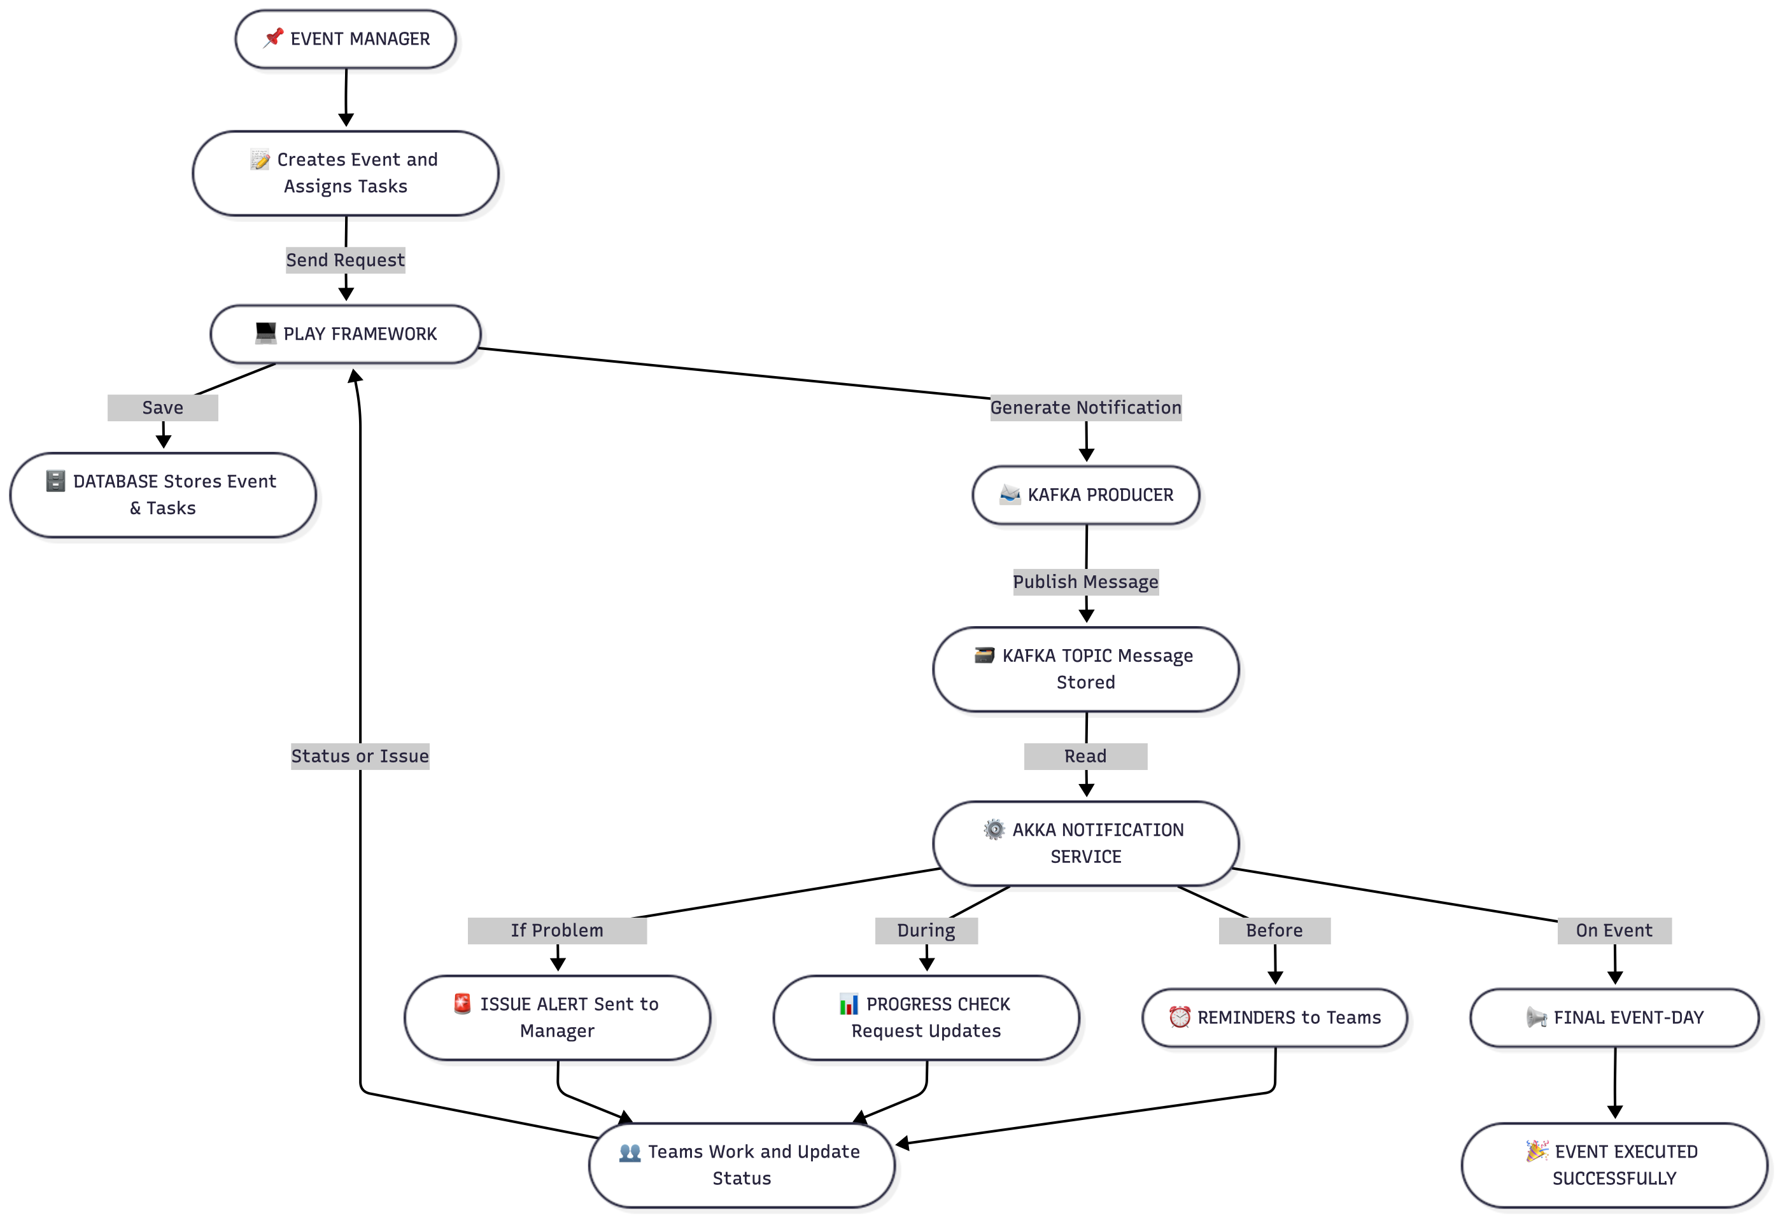





FUNCTIONAL FLOW DIAGRAM
Event Creation
Event Notification
Task Assignment
Kafka Producer
Play Framework
Task Completion
Data Persistence
Akka Microservice
User Interface
Slick ORM + MySQL
The system workflow demonstrates an event-driven architecture where Play Framework handles event and task management, Kafka facilitates communication between components, and Akka processes notifications and scheduling.
Event Management System
5/11

Slide 6

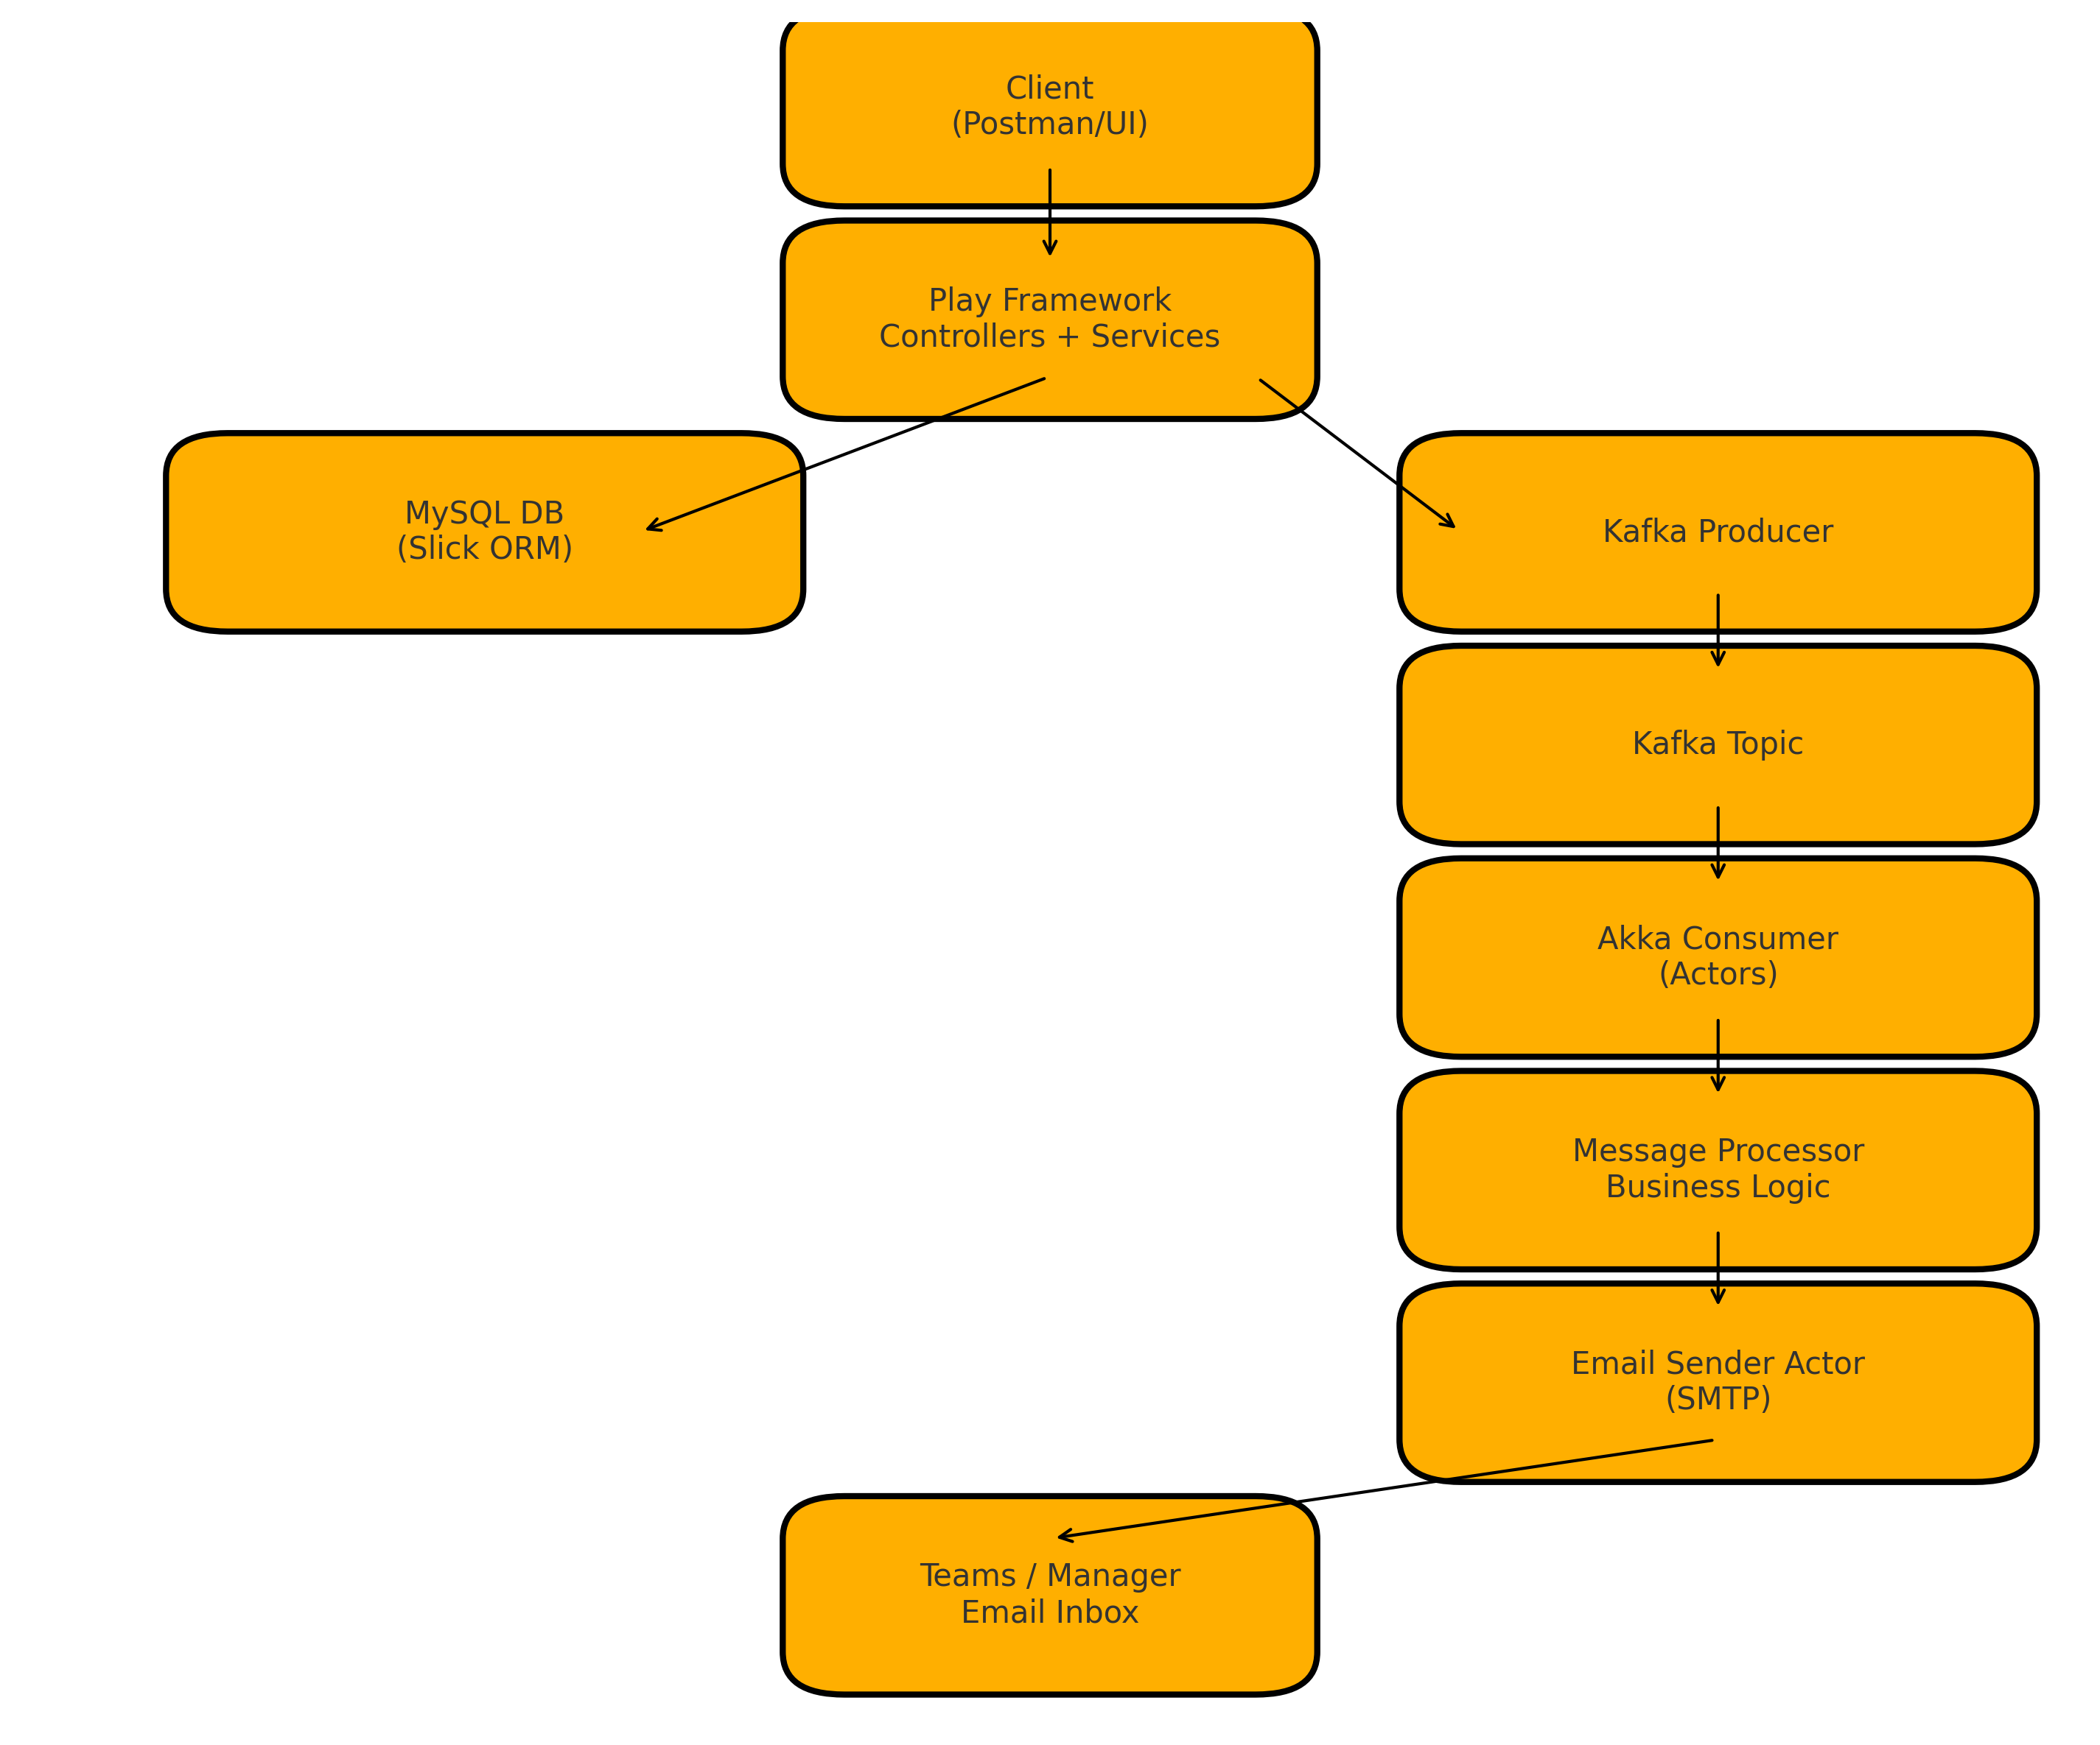




OVERALL ARCHITECTURE DIAGRAM
Data Flow
Event Management System
6/11

Slide 7




















DEPLOYMENT PLAN
Play Monolith
Akka Microservice
Deployed Locally
Deployed Separately
Kafka Broker
Hosted Locally
MySQL Database
Persistent Storage
Play Framework
Kafka
Monolithic backend deployed locally, serving as main API entry point.
Broker hosted locally, facilitating communication via topics.
Akka Microservice
MySQL
Separately deployed, handles Kafka consumption and notifications.
Database for persistence, integrated with Play Framework via Slick.
Event Management System
7/11

Slide 8
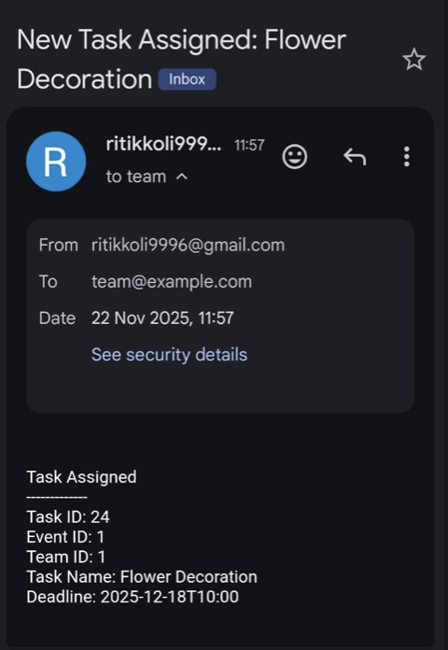

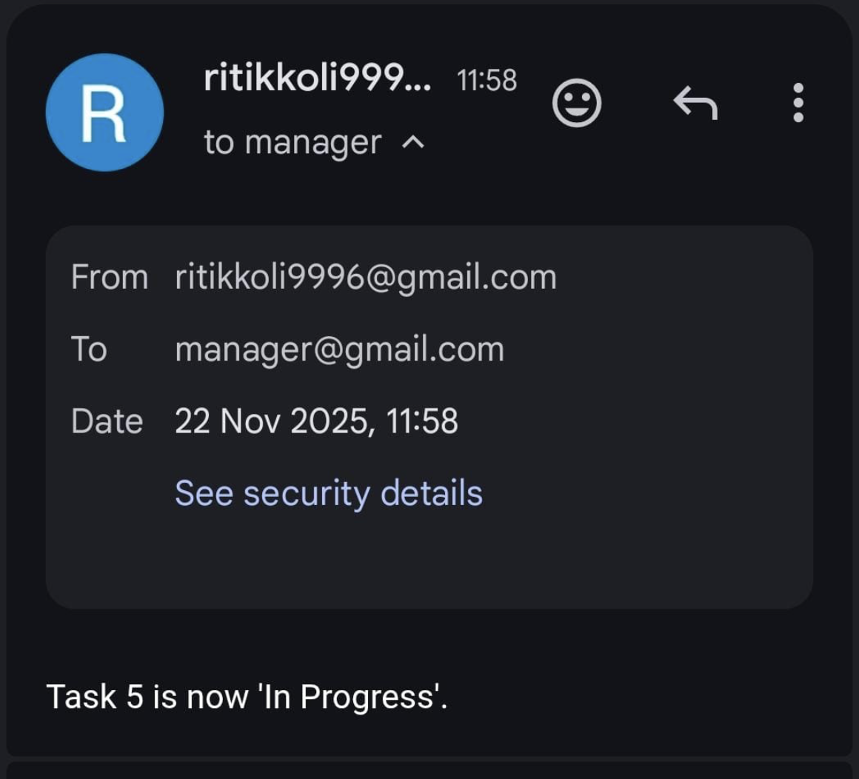
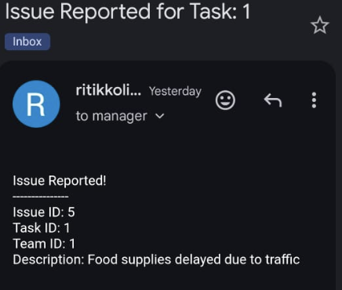
OUTPUT
Event Management System
8/11

Slide 9



















TECH FEATURES IMPLEMENTED
Scala
Play Framework
Functional + OOP mix using case classes
REST APIs for Events/Tasks/Issues
Async operations with Future
JSON handling with play-json
Type-safe models & DB mapping
Slick integration for type-safe DB access
Akka
Kafka
Actors for processing & email notifications
Play app publishes event/task messages
Akka Streams for Kafka consumption
Akka microservice consumes & triggers notifications
Scheduler for periodic reminders
Event-driven, decoupled communication
Event Management System
9/11

Slide 10
















CONCLUSION & FUTURE SCOPE
Project Outcomes
Future Scope
Event Coordination
Scalability Enhancements
Successfully integrated multiple service teams through a unified event management platform.
Implement cluster scaling and load distribution for handling larger events and higher concurrency.
System Efficiency
Mobile Application
Reduced delays and improved coordination through automated workflows and real-time notifications.
Develop native mobile apps for iOS and Android to provide on-the-go access to event information.
Technology Implementation
AI Integration
Successfully implemented Play Framework, Kafka, and Akka to create a robust event management system.
Incorporate machine learning for predictive analytics and intelligent task allocation.
Event Management System
10/11

Slide 11










THANK YOU
Thank you for your attention and time.
Event Management System
11/11

